Slide 1
ADVERTISING
Moneeba Iftikhar

Slide 2
WHAT DOES ADVERTISING MEAN?
Advertising Simply Means A Way Of Communication That Reaches All Types Of Sector
It Provides Information And Creates Awareness Among People Relating To A Product Etc
DEFINITION
Any paid form of non-personal presentation and promotion of ideas, goods or services by an identified sponsor

Slide 4
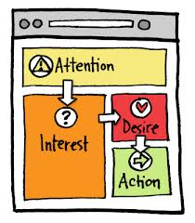
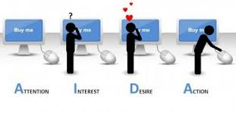
In Short AIDA Principle:
Attract Attention – Capture reader
Create Interest – You keen to find out more
Develop Desire – Feel a need to buy
Promote Action – Information that you will need to buy

Slide 5
Mission
Measure
Media
Message
Money
Advertising

Slide 6
Purpose Of Advertising
Delivering the proper message to customers
To convince customers that a company’s services or products are best
Enhance the Image of company
Demonstrate new uses for established products to hold existing customers

Slide 7
TYPES OF ADVERTISING OBJECTIVE
INFORMATIVE ADVERTISING
New Product, New Service, New Features, Re-Launch
PERSUASIVE ADVERTISING
Comparative Ads
REMINDER ADVERTISING
Continuous Ads
Ex: Coca Cola

Slide 8
INFORMATIVE ADVERTISING
Building A Brand And Company Image
Telling The Market About A New Product
Explaining How The Product Works
Suggesting New Usage Of A Product
Informing The Market Of A Price Change
Describing Available Services And Support
Correcting False Impression

Slide 9
PERSUASIVE ADVERTISING
Building Brand Preference
Encouraging Switching To Your Brand
Persuading Customers To Purchase New
Convincing Customers To Tell Others About The Brand

Slide 10
REMINDER ADVERTISING
Maintaining Customer Relationship
Reminding Consumers That The Product May Be Needed In The Near Future
Reminding Consumers Where To Buy The Product

Slide 11
SETTING THE ADVERTISING BUDGET
Affordable Method
Percentage Of Sales Method
Competitive Parity Method
Based On Product Life Cycle

Slide 12
Functions :

Slide 13
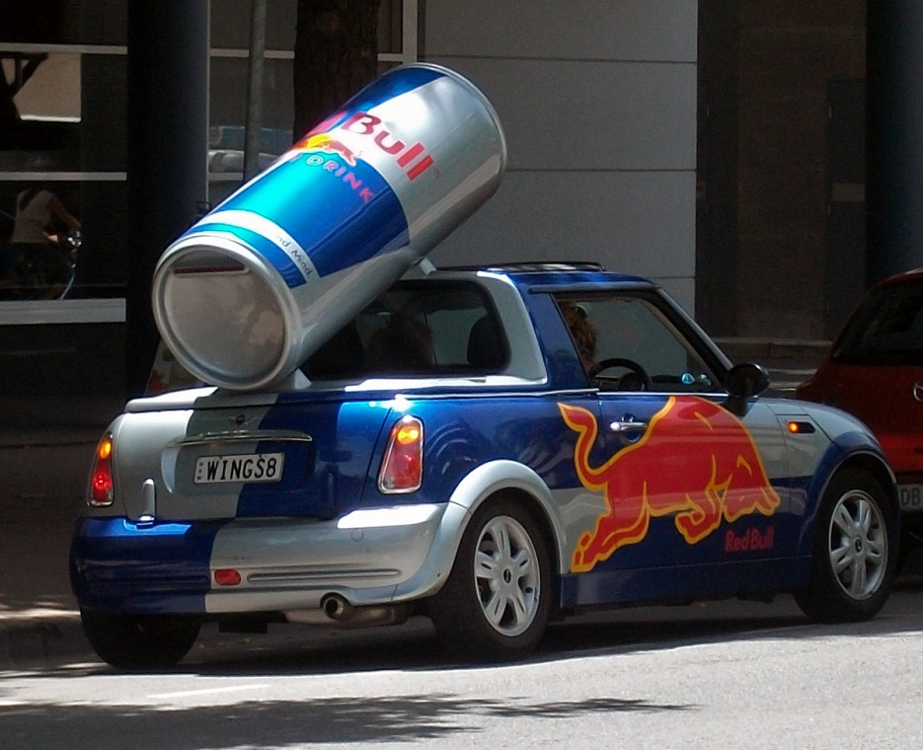
Type Of Advertising Media
Outdoor Advertising (Billboard, Transport)
Media Advertising (Television, Radio)
Print Advertising (Newspaper, Magazine)
Internet Advertising
Celebrity Advertising
Cinema Advertising
Retailer/Local Advertising
Brand Advertising

Slide 14
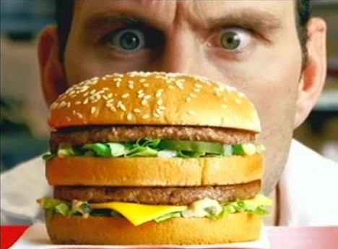
Five Players In Advertising
1. Advertiser
2.Advertising Agency
3. Media
4.Vendors
5.Target Audience

Slide 15
Role Of Advertising
Marketing Role
Communication Role
Economic Role
Social Role

Slide 16
Classification Of Advertising
On Geographical basis
Global
National
Regional
Local
On Basis of Target Groups
Consumers
Professional
On basis of Demand
Product demand
Brand demand
Advertising of service
Hotel services
Education services
Transportation services
Hospitality services
Financial service

Slide 17
Examples of Top Advertising Agencies
Ogilvy & Mather- Hutch (Vodafone), Cadbury, Asian Paints and Fevicol.
JWT, J Walter Thompson- Nestle, Ford, Nokia and Unilever.
Mudra Communication- HBO, Philips, Reliance NetConnect, Big Bazaar.
FCB Ulka Advertising Ltd-Tata Indicom, Whirlpool, Zee Cinema, Santoor, Sunfeast and Amul.
Grey Worldwide (I) Pvt. Ltd- Hero Honda, Maruti Suzuki, Nestle, Ambuja Cement, UTV, P&G and Godrej

